Slide 1
TRAIN
PAZZLE
WEBSITE

Slide 2
This project report details the development process of a web application called "Train Track Mystery." This application is an advanced web game developed using full-stack technologies, designed to showcase the developers' sophisticated web development skills. The game seamlessly integrates front-end responsive design, back-end APIs, and secure database management. The webpage primarily uses a train puzzle game to help users experience the charm of focus and problem-solving in their leisure time, and to compare their scores with those of other players to identify areas for improvement in focus and problem-solving abilities.
CONTEXT AND INTRODUTION

Slide 3

Responsible for main page designing and login system Programing
JOHN DC226991

Slide 4
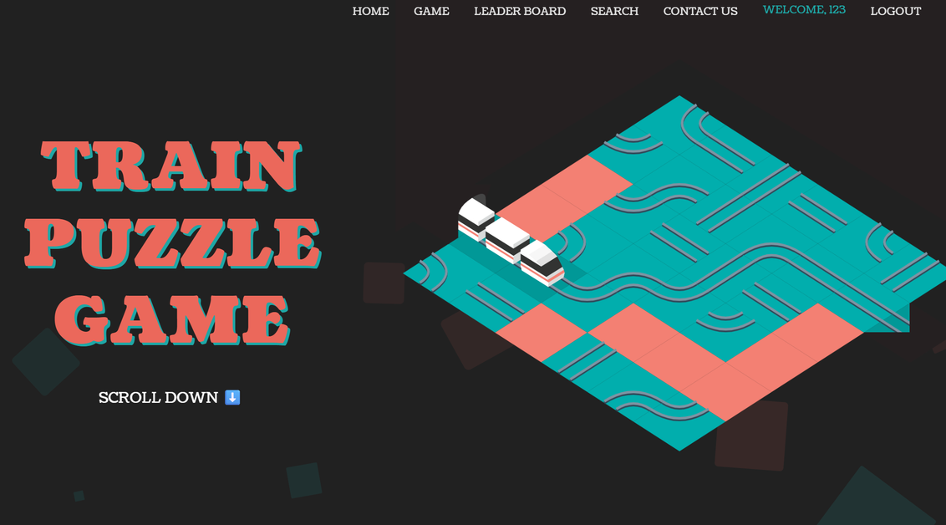
"This is the homepage of our train puzzle game website. The overall design is simple and intuitive, allowing players to quickly choose to log in or directly experience the game. The homepage highlights the game theme and provides clear navigation, enabling users to understand the website's functions and goals at a glance."

Slide 5
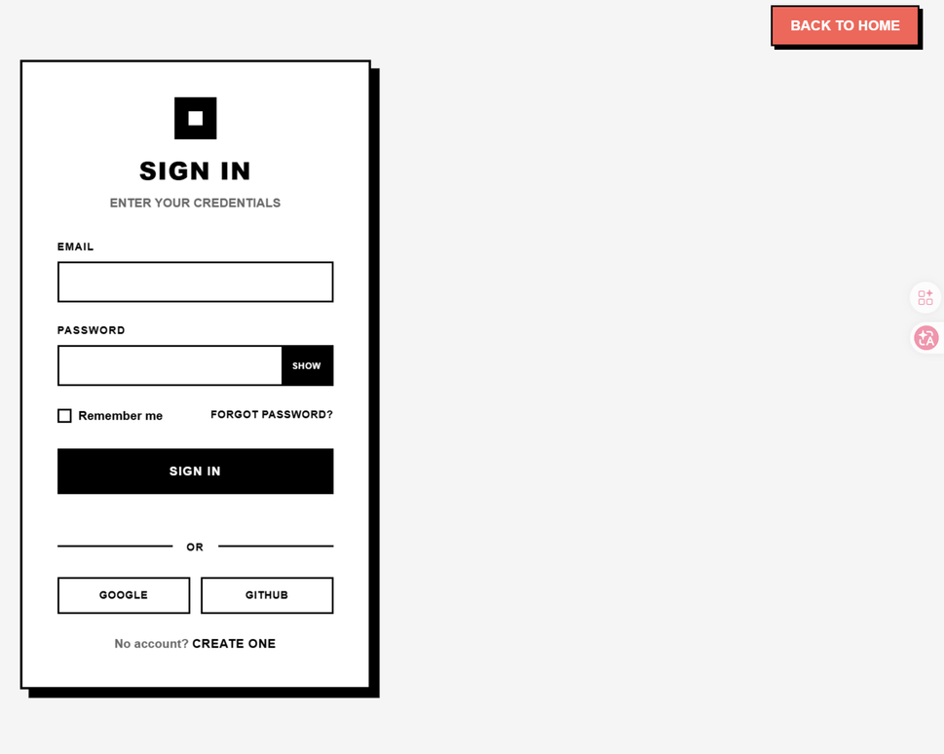
PIXEL DETAILS WITH PURPOSE
The website offers a secure login system. Players can enter the game using their account and password. The system supports password retrieval and identity verification to ensure data security. After logging in, players' game progress and scores are automatically linked to their personal accounts, allowing them to continue challenging themselves at any time.

Slide 6


Responsible for Game machanism and Report writing
XU WUSIYUAN
(BRUCE)
CHAN HIO TOU
(COLLINS)

Slide 7
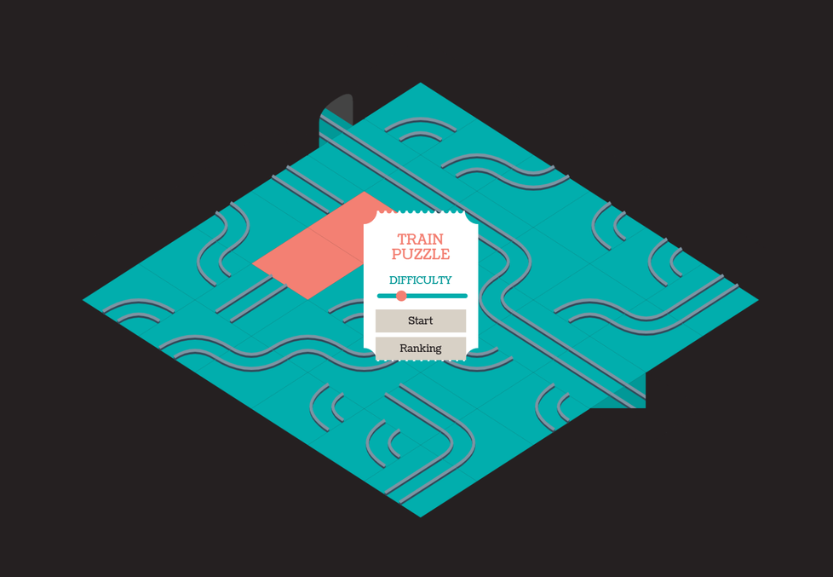
GAME PAGE
The game system consists of ten levels, each with unique train track puzzles that gradually increase in difficulty

Slide 8
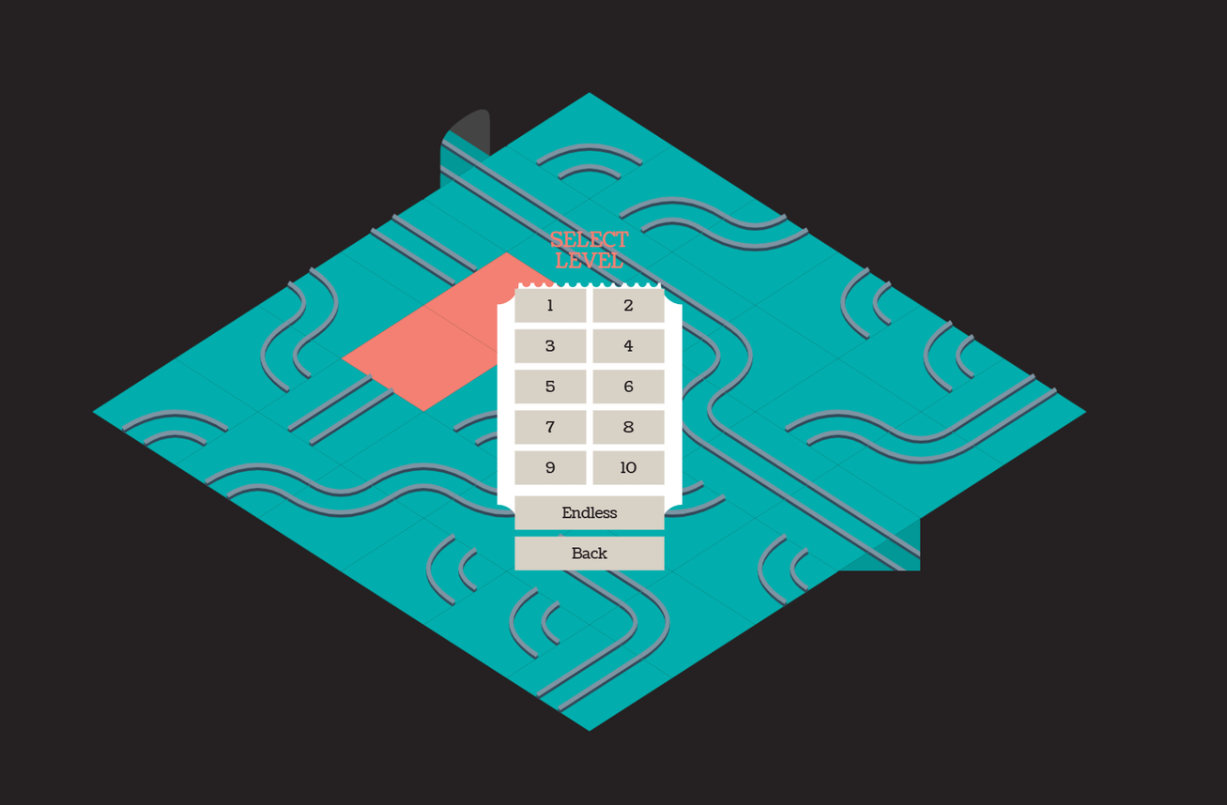
In addition to the level-based mode, we've also designed an endless mode, allowing players to keep challenging themselves until they fail. This caters to both casual players and those seeking a more challenging experience.

Slide 9


SEKI TOMOKI
Responsible for backend
CHEN JOAQUIN ANTONIO

Slide 10
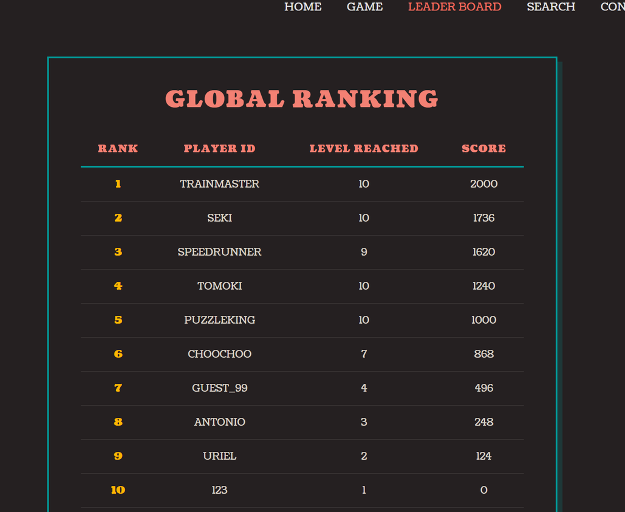
On the backend, we implemented a leaderboard system. Scores in Endless Mode are automatically uploaded and recorded, and players can view their rankings on the leaderboard. The system also supports a search function, allowing players to enter their username to quickly find their own or other players' scores, enhancing interactivity and the sense of competition.

Slide 11
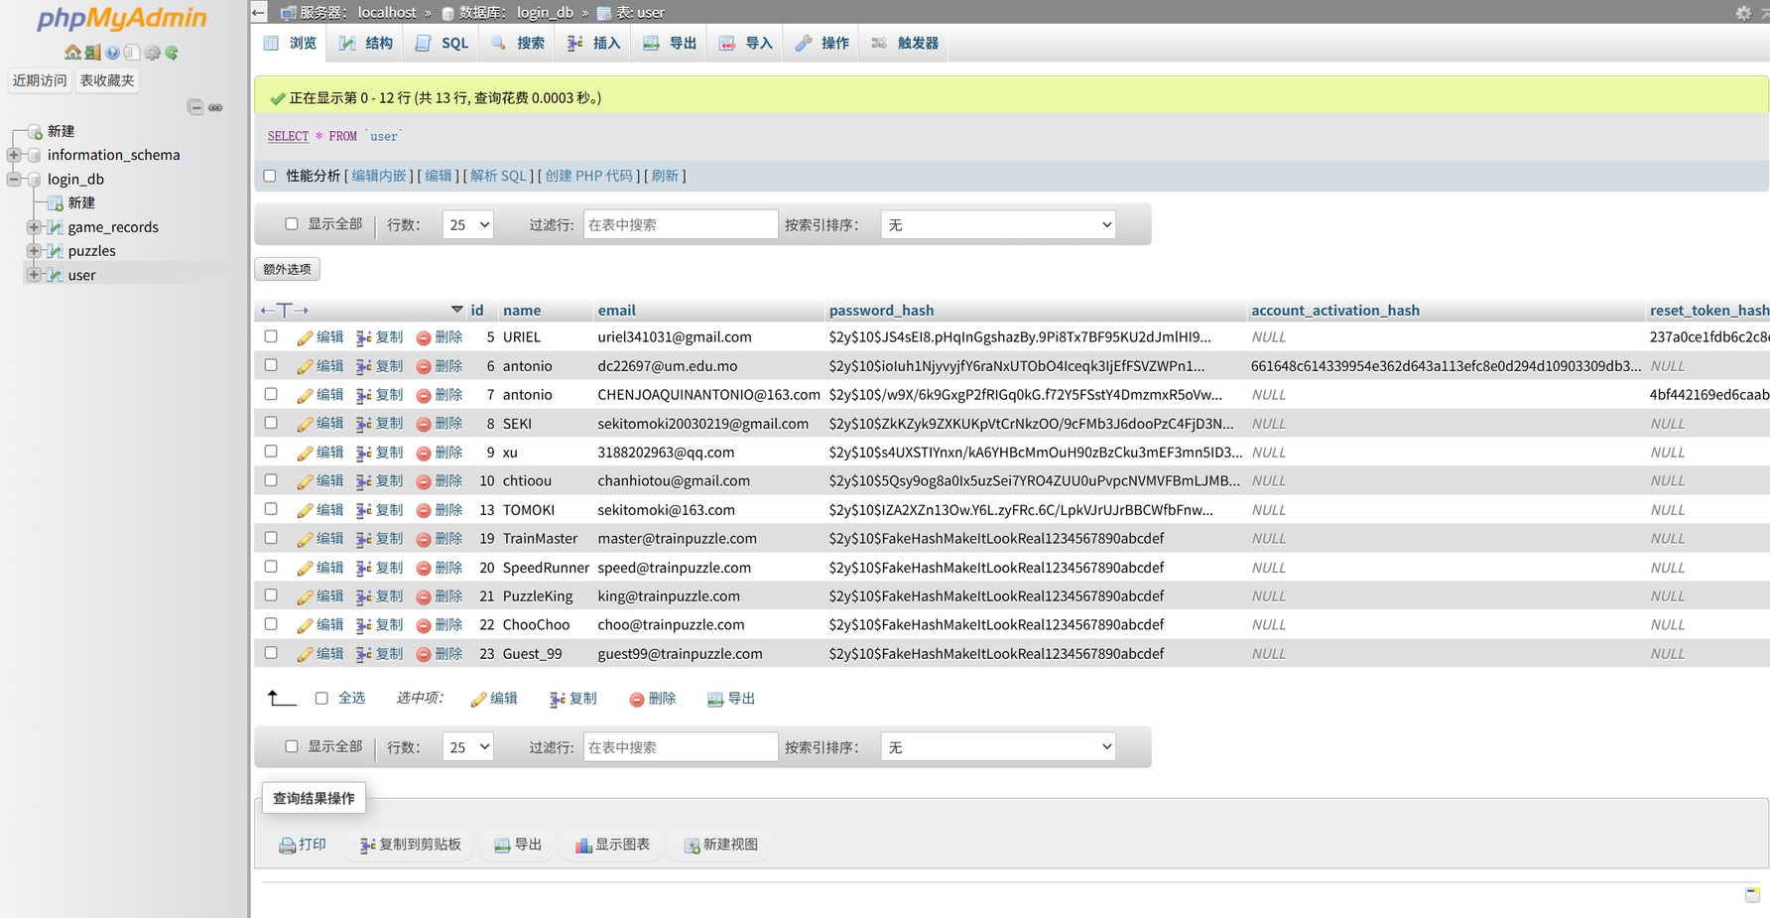

Slide 12

Responsible for leaderboard mechanism and search system
URIEL WULI

Slide 13
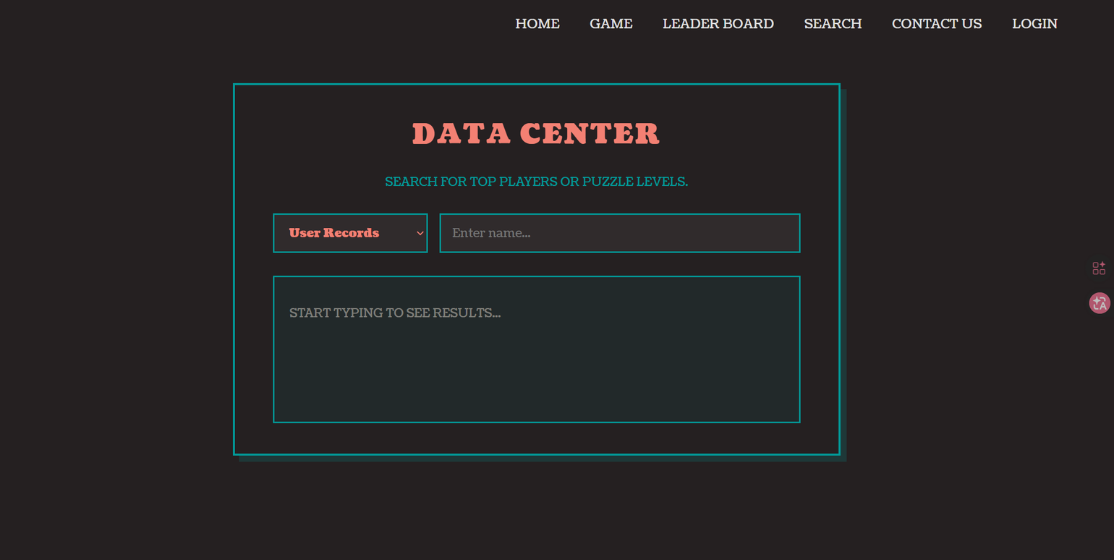

Slide 14
THANK YOU！
SPEAK BY JOHN

